Slide 1
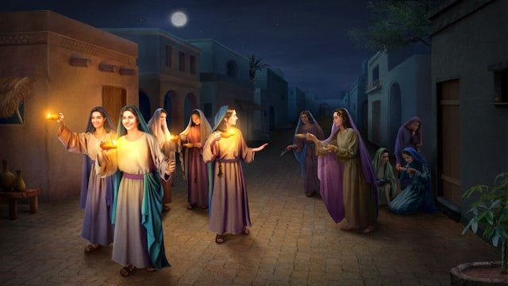
THE PARABLE OF THE
TEN VIRGINS
Mat. 25:1-13

Slide 2
The Parable of the Ten Virgins
25 “At that time the kingdom of heaven will be like ten virgins who took their lamps and went out to meet the bridegroom. ² Five of them were foolish and five were wise. ³ The foolish ones took their lamps but did not take any oil with them. ⁴ The wise ones, however, took oil in jars along with their lamps. ⁵ The bridegroom was a long time in coming, and they all became drowsy and fell asleep.

Slide 3
⁶ “At midnight the cry rang out: ‘Here’s the bridegroom! Come out to meet him!’
⁷ “Then all the virgins woke up and trimmed their lamps. ⁸ The foolish ones said to the wise, ‘Give us some of your oil; our lamps are going out.’
⁹ “‘No,’ they replied, ‘there may not be enough for both us and you. Instead, go to those who sell oil and buy some for yourselves.’

Slide 4
¹⁰ “But while they were on their way to buy the oil, the bridegroom arrived. The virgins who were ready went in with him to the wedding banquet. And the door was shut.
¹¹ “Later the others also came. ‘Lord, Lord,’ they said, ‘open the door for us!’
¹² “But he replied, ‘Truly I tell you, I don’t know you.’
¹³ “Therefore keep watch, because you do not know the day or the hour.

Slide 5
THIS PARABLE EMPHASIZES THAT ALL CHRISTIANS MUST ALWAYS EXAMINE THEIR OWN SPIRITUAL CONDITION IN THE LIGHT OF CHRIST’S RETURN.

Slide 6
THE BIBLE TEACHES THAT JESUS CHRIST IS THE “BRIDEGROOM”
2 Corinthians 11:2-3;
Revelation 19:7-10

Slide 7
THE BIBLE TEACHES THAT JESUS CHRIST IS THE “BRIDEGROOM”
2 Corinthians 11:2-3;
Revelation 19:7-10

Slide 8
I. WHO ARE THE TEN VIRGINS? (V. 1)

Slide 9
ALL WHO PROFESS OUTWARDLY CHRIST AS SAVIOR AND LORD.

Slide 10
II. THE CLASSIFICATION OF THE TEN VIRGIN.
(VV. 2-4)

Slide 11
THE 5 FOOLISH
THESE 5 HAD LAMPS BUT NO ADEQUATE PROVISION OF OIL
THEY NEGLECTED TO PREPARE FOR THE FUTURE

Slide 12
THE 5 FOOLISH
THEY FAILED TO RECOGNIZE THAT THE BRIDEGROOM WILL COME AT AN UNEXPECTED TIME
THEY ARE “RELIGIOUS” BUT ARE NOT COMMITTED TO CHRIST

Slide 13
THE 5 FOOLISH
THEY FAILED TO RECOGNIZE THAT THE BRIDEGROOM WILL COME AT AN UNEXPECTED TIME
THEY ARE “RELIGIOUS” BUT ARE NOT COMMITTED TO CHRIST

Slide 14
THE 5 WISE
THE PROFESSION OF FAITH OF THE WISE ARE GENUINE
THEY UNDERSTAND THE IMPORTANCE OF PREPAREDNESS

Slide 15
THE 5 WISE
THEY PREPARE THEIR LAMPS AND HAD AMPLE OIL
THEY WANTED TO BE FOUND FAITHFUL AND READY FOR THE BRIDEGROOM’S COMING

Slide 16
PREPARE FOR ETERNITY

Slide 17
III. THE DELAY OF THE BRIDEGROOM’S COMING (VV.5-6)

Slide 18
The bridegroom was a long time in coming, and they became drowsy and fell asleep. (v.5)
THE BRIDEGROOM DID NOT APPEAR SO EARLY AS EXPECTED.

Slide 19
* THERE’S A TIME WHEN THERE’S NO MORE “DELAY”(REV. 10:6-7)
WHY IS THERE A “DELAY”?

Slide 20
IV. THE CONSEQUENCES OF UNPREPAREDNESS

Slide 21
THE FOOLISH ONES
HAVE NO OIL
“GIVE US SOME OF YOUR OIL, OUR LAMPS ARE GOING OUT” v.7-8

Slide 22
THE OIL – REPRESENTS TRUE FAITH, RIGHTEOUSNESS AND THE ABIDING PRESENCE OF THE HOLY SPIRIT

Slide 23
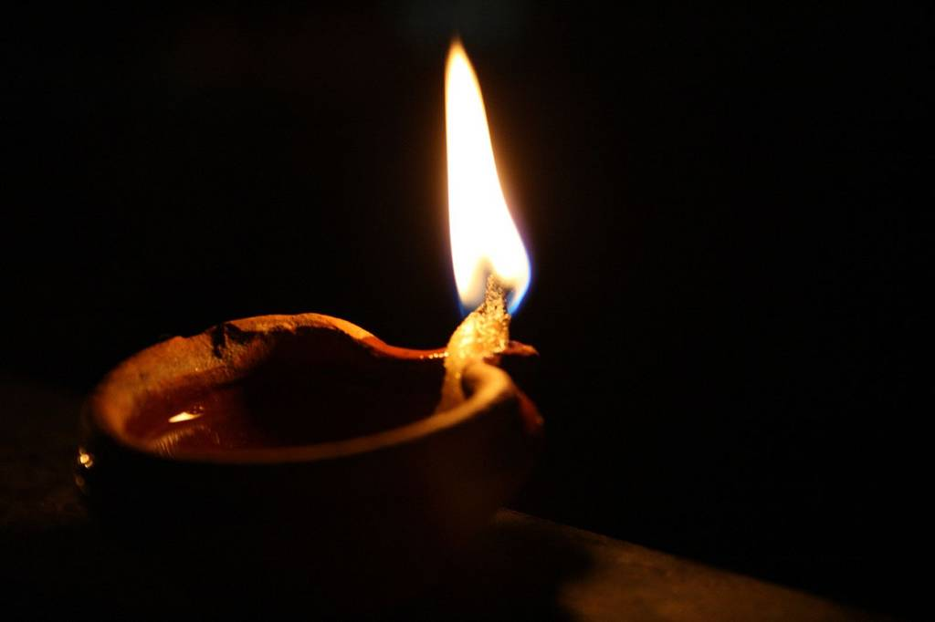

IS YOUR LAMP GOING OUT --- BECAUSE OF LACK OF “OIL”?

Slide 24
THE 5 WISE JOINED THE BRIDEGROOM IN THE WEDDING

Slide 25
THE 5 FOOLISH ONES WERE SHUT OUT FOREVER
v.10-12

Slide 26
CONCLUSION:
“THEREFORE KEEP WATCH, BECAUSE YOU DO NOT KNOW THE DAY OR THE HOUR.
MATTHEW 25:13

